Slide 1


RECELL Autologous Burn Therapy System
Courtney Schoppe

Slide 2
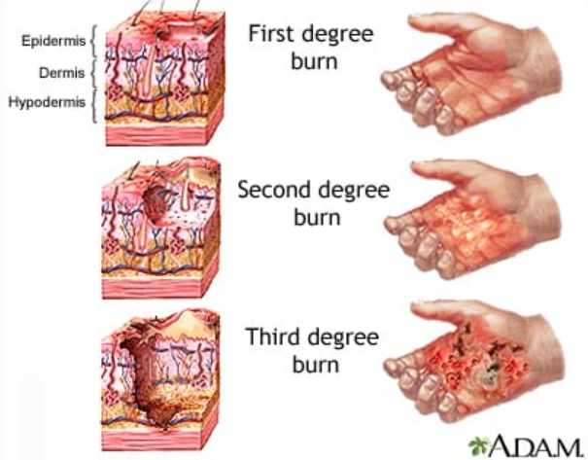
The Problem
Burns cause physical and emotional harm
450,000 patients seen every year
30,000 in specialized facilities [1]
Limitations on current technology
Lack of grafting material
Disease transmission
Immune reactions
https://blog.nols.edu/2015/09/04/treating-burns-in-the-backcountry

Slide 3
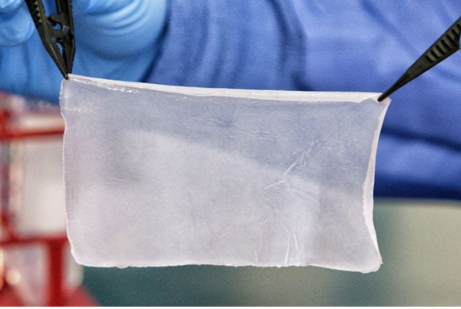
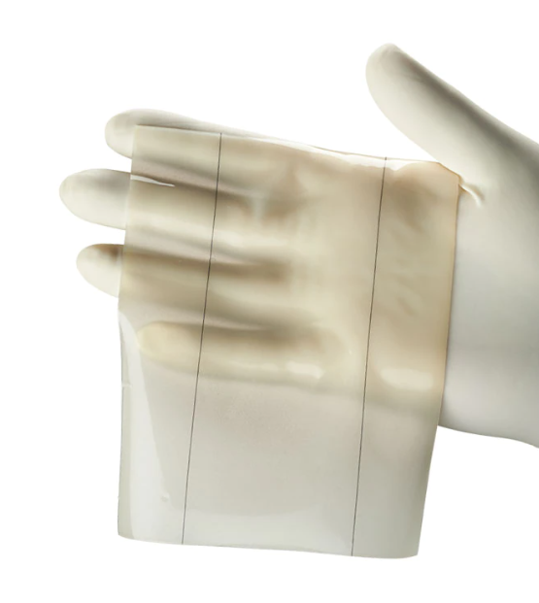
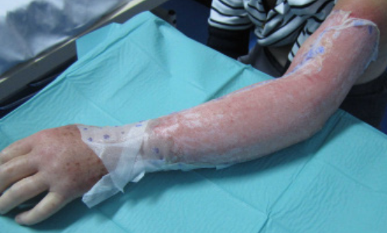
The Problem
Integra Graft
StrataGraft
Biobrane Wound Dressing
https://www.stratagraft.com/about/, https://www.integralife.com/integra-dermal-regeneration-template/product/wound-reconstruction-care-inpatient-acute-or-integra-dermal-regeneration-template, https://www.nbt.nhs.uk/our-services/a-z-services/burns/burns-patient-information/biobranetm-dressing

Slide 4
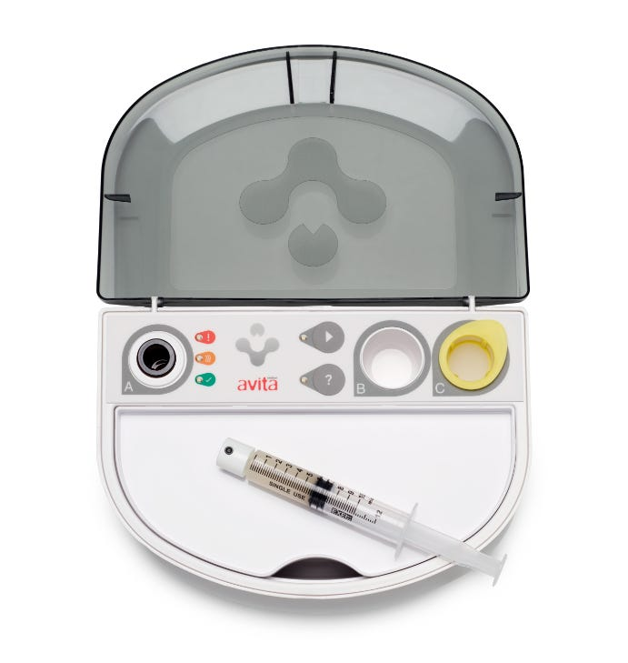
The RECELL System
Smaller autograft needed [2]
Reduction in:
Number of procedures
Length of hospital stay
Pain and scarring [2]
Design Characteristics:
Cost effective
Usability
Biocompatible
Sterile
Long Shelf Life
Cell proliferation
https://recellsystem.com/about-recell-system/how-it-works/

Slide 5
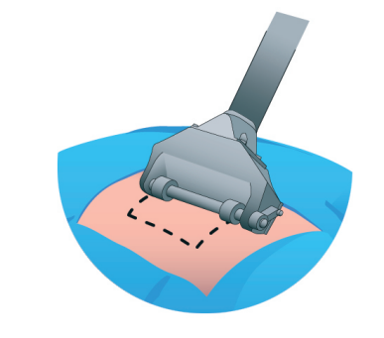
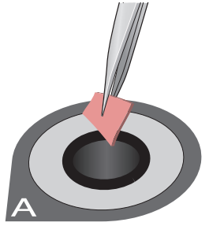
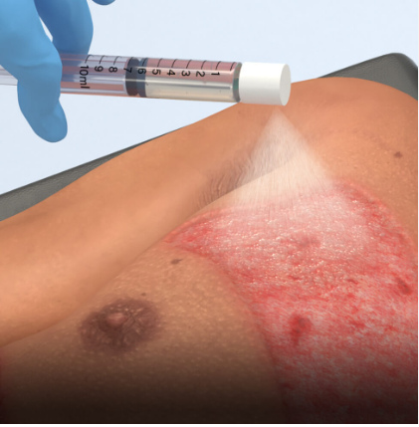
How it Works
Skin graft is collected
Graft is added to the enzyme solution and prepared
Regenerative Epidermal Suspension sprayed onto patient
https://www.fda.gov/media/116368/download

Slide 6
Verification & Validation
Verification
Validation
Cost analysis [3]
2% cost difference
Over all 14-17.3% savings
Functionality tests [4]
Spray nozzle
RPU
Enzyme Actvity
Integrated tests [4]
Cell viability
Reproducibility
Biocompatibility test [4]
Randomized clinical trial [5]
101 test subjects
End Points
Site healing
Percent epithelialization
Pain
Patient Satisfaction
Safety
Results
Safe and effective
-2.4% inferiority effective endpoint

Slide 7
References
Schaefer, Timothy J., and Shruti C. Tannan. “Thermal Burns.” StatPearls, 30 May 2022, https://doi.org/https://www.ncbi.nlm.nih.gov/books/NBK430773/.
“Avita Medical Announces First U.S. Sales of RECELL® System and Commencement of Commercial Shipping.” AVITA Medical Announces First U.S. Sales of RECELL® System and Commencement of Commercial Shipping | Business Wire, 17 Oct. 2018, https://www.businesswire.com/news/home/20181017005965/en/AVITA-Medical-Announces-First-U.S.-Sales-of-RECELL%C2%AE-System-and-Commencement-of-Commercial-Shipping.
Kowal, S., Kruger, E., Bilir, P., Holmes, J. H., Hickerson, W., Foster, K., Nystrom, S., Sparks, J., Iyer, N., Bush, K., & Quick, A. (2019). Cost-effectiveness of the use of autologous cell harvesting device compared to standard of care for treatment of severe burns in the United States. Advances in Therapy, 36(7), 1715–1729. https://doi.org/10.1007/s12325-019-00961-2
Center for Biologics Evaluation and Research. (n.d.). RECELL® Autologous Cell Harvesting device. U.S. Food and Drug Administration. Retrieved November 7, 2022, from https://www.fda.gov/vaccines-blood-biologics/approved-blood-products/recell-autologous-cell-harvesting-device
Hickerson, W. L., Molnar, J. A., Carter, J. E., Cairns, B. A., Hwang, J., King, B. T., Cruse, C. W., Smith, D. J., Sood, R., Feldman, M. J., Greenhalgh, D. G., Palmieri, T. L., Dissanaike, S. D., Griswold, J. A., Peck, M. D., Foster, K., Mozingo, D. W., Jordan, M. H., & Holmes, J. H. (2018). T1 A Comparative Study of autologous skin cell suspension to split-thickness autografting in the treatment of Acute Burns. Journal of Burn Care & Research, 39(suppl_1). https://doi.org/10.1093/jbcr/iry006.000

